Slide 1

University Safety Management System
INFO - 6210 Data Management and Database Design
Submitted by Data Diggers

Slide 2
Background
Safety departments are required to proactively ensure the safety of the people
They need to be prepared for all adversities
This process is impeded if the organization is not structured properly.

Slide 3
Solution
We aim to provide a better approach for organizing their records with the help of a database system
The system will help the safety department to reduce the time required for data processing and spend more time providing security to the university community

Slide 4
Problems Addressed
Efficient storage of details about the employees
Detailed shift information of the employees that are assigned a particular shift
Data of the units or sub – divisions in the department
Details about the services provided
Stores data about the various enrollments/ services
Contains data about the entire University Community
Details about the property registrations
All incident details, along with their respective reports

Slide 5
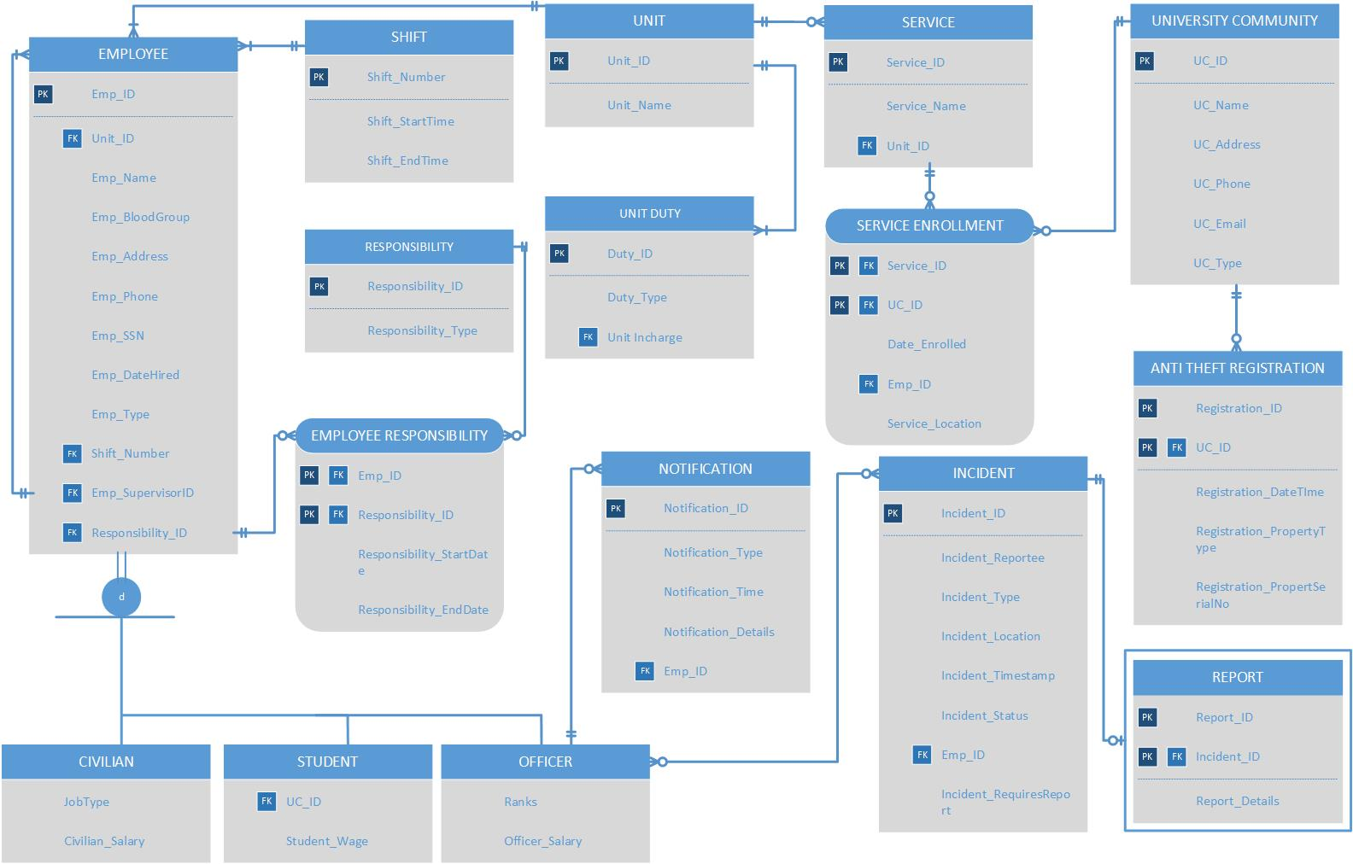
Final ERD

Slide 6
DDL Statements
Some important entities like Employee ( Subtype and Supertype), Service Enrolment and Incident required special attention.
Most of the relations are through these entities.
Employee and Service Enrolment make up most of the relations whereas Incident is a crucial entity on its own

Slide 7
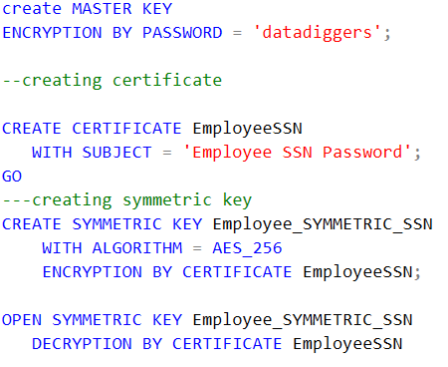
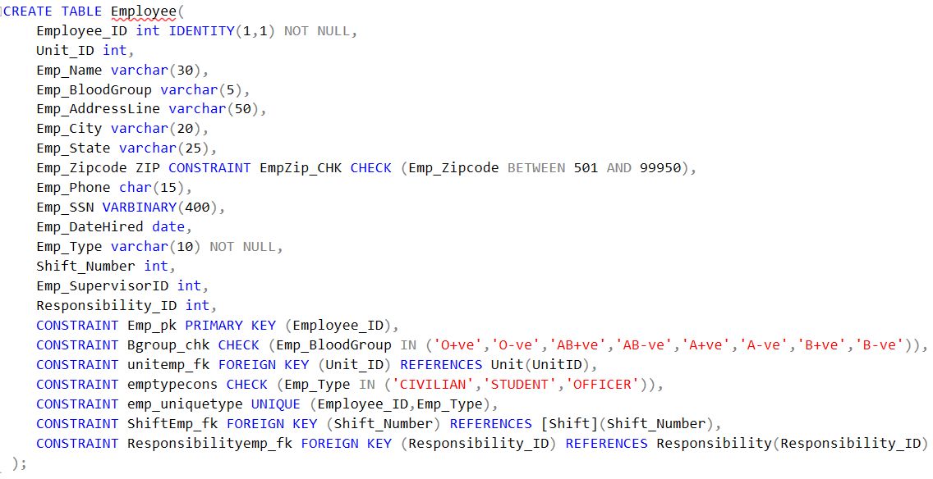
Employee Supertype
Employee has 3 subtypes – Civilian, Student, Officer
Each employee will definitely belong to one of the 3 subtypes.
Implemented through the Unique constraint.
Also consists of Encrypted Column for SSN.

Slide 8
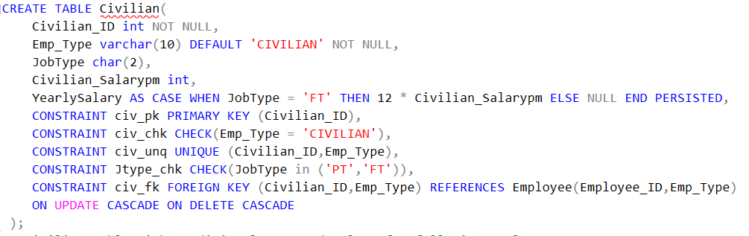
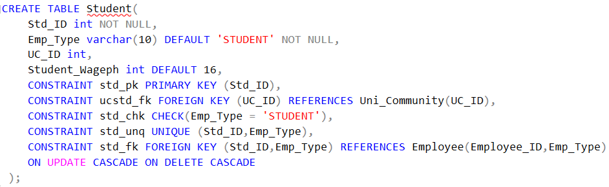
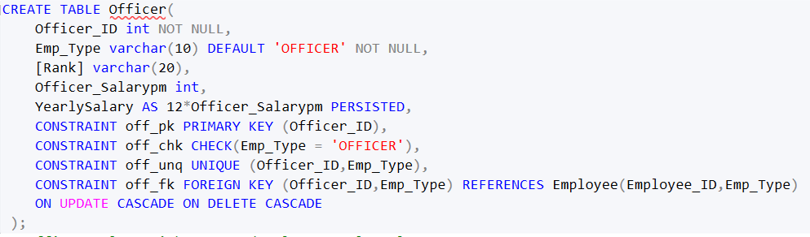
Employee Subtype
The disjointness is implemented by ensuring the Unique constraint in each of the subtypes
Full time Civilians and Officers have a computed column called yearly salary.
For students, their UC_ID is also stored.

Slide 9
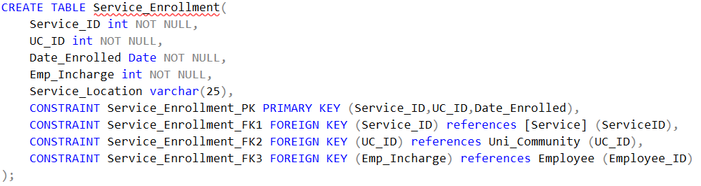
Service Enrollment
Tracks community enrolment in the services provided such as Self Defense Training, Redeye, etc.
Potentially can contain the entire University Community.
However, realistically, it is not the case.
Can partition horizontally by date to speed up retrieval in the future.

Slide 10
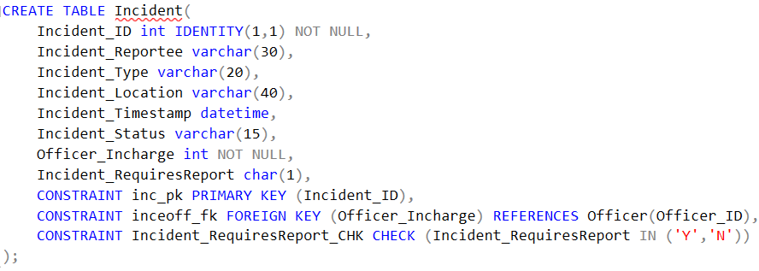
Incident
Arguably the most important entity of the Management System.
Requires an entry from the officer table to store information of Officer Incharge.
Report required is also used to keep track of reports table.

Slide 11
Database Objects
Implemented triggers, procedures and views.
Triggers largely implemented to allow for ease of insertion and avoiding re-entering data to maintain data integrity.
Procedures implemented to easily insert additional attributes to employee information.
Views created to provide some important grouping of data.

Slide 12
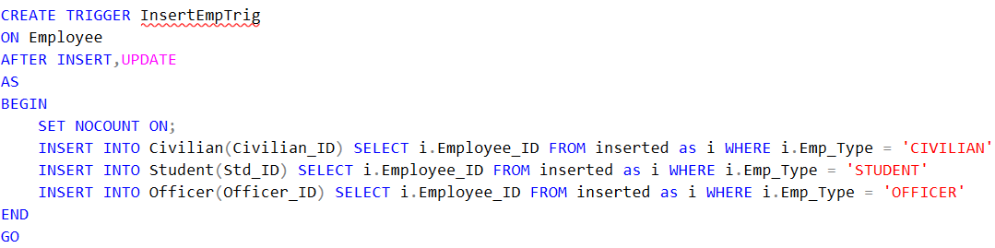
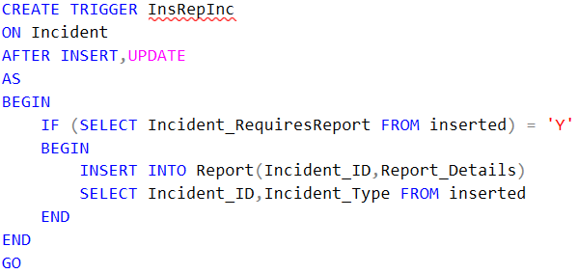
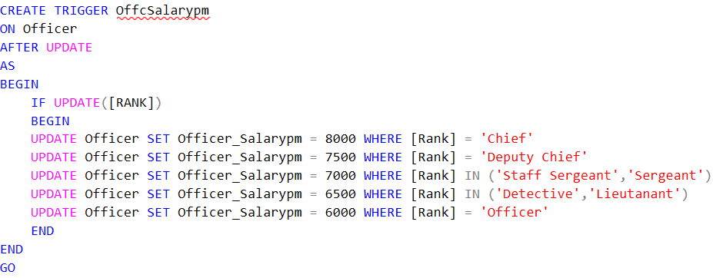
Triggers
The InsertEmpTrig automatically populates the subtype tables when the employee table is filled.
The InsRepInc inserts a report into the report table if a report is required for an incident.
The OffcSalarypm updates the salary of the officer based on their designations.

Slide 13
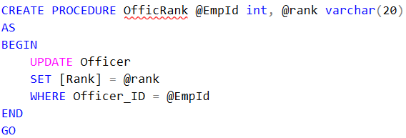
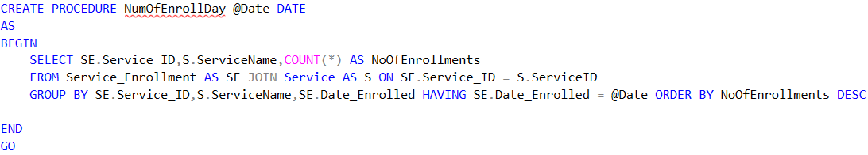
Procedures
The procedure OfficRank helps us update the rank of the Officers.
NumOfEnrollDay, upon being passed the date, gives us the number of enrolments per service.

Slide 14
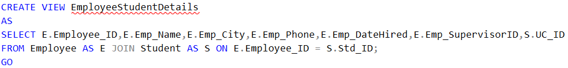
Views
The view EmployeeStudentDetails give the details of student employees.
The view EmpUnitDetails gives the important employee details, along with their unit details.

Slide 15
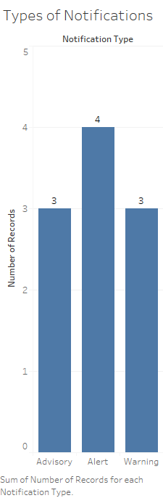
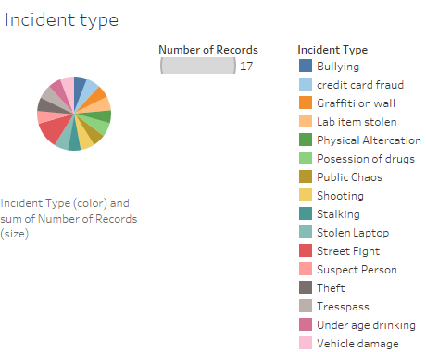
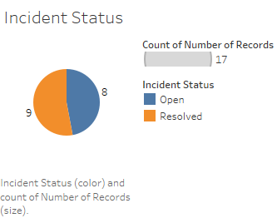
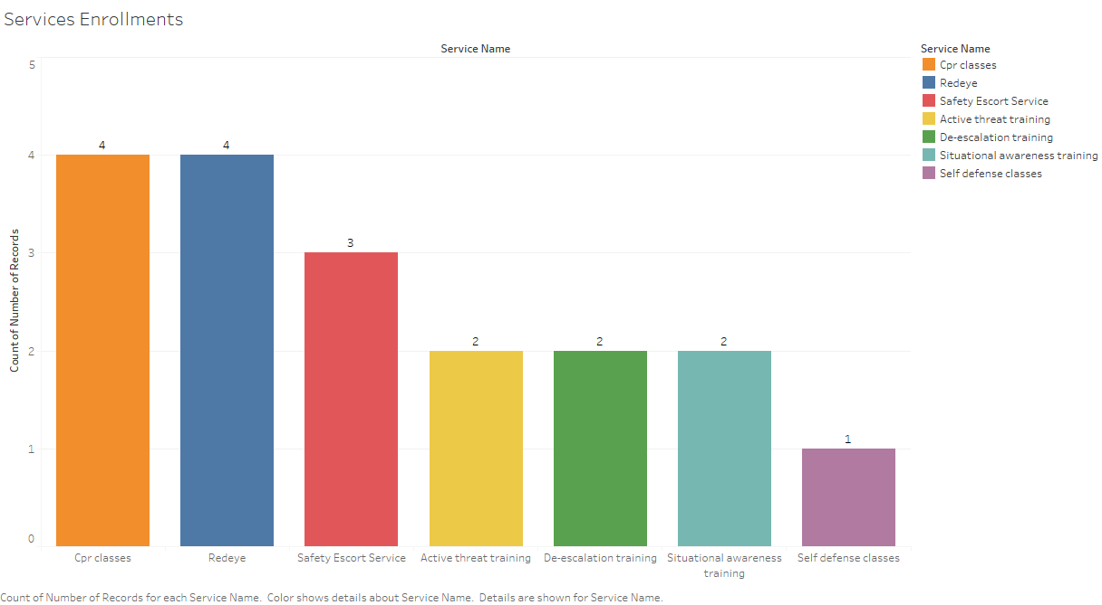
Reports

Slide 16
THANK YOU

